Slide 1

Web Development & Design Foundations with HTML5
Tenth Edition
Chapter 13
Web Promotion
Copyright © 2021, 2019, 2017 Pearson Education, Inc. All Rights Reserved

Slide 2
Learning Outcomes
In this chapter, you will learn how to ...
Identify commonly used search engines and search indexes
Describe the components of a search engine
Design web pages that are friendly to search engines
Submit a website for inclusion in a search engine or search directory
Monitor a search engine listing
Describe other website promotion activities
Use the iframe element to create an inline frame

Slide 3
Popular Search Engines
Market Share Survey Results for a Recent Month:
Google 76%
Baidu 9.64%
Bing 8.59%
Yahoo! 3.16%
Source: http://www.netmarketshare.com/search-engine-market-share.aspx?qprid=4&qpcustomd=0

Slide 4
Search Engine Components
Popular Search Engines:
Google http://www.google.com
Bing http://bing.com
Search engines use the following components:
Robot or “spider”
Database (also used by search indexes)
Search form (also used by search indexes)

Slide 5
Search Engine Robot (1 of 2)
Also called a spider or bot
A computer program that follows hyperlinks and “walks” the Web – accessing and documenting web pages.
Categorizes the pages and stores information in a database.

Slide 6
Search Engine Robot (2 of 2)
May access the following components of web pages:
title
meta tag keywords & meta tag description
text in headings
other text on the page
hyperlinks
See https://www.robotstxt.org

Slide 7
Search Engine Database
Database:
A collection of information organized so that its contents can easily be accessed, managed, and updated.
Database Management Systems (DBMSs)
Configure and manage database
Oracle, MySQL, Microsoft SQL Server, IBM DB2
Search Engine Database
Contains information about web pages

Slide 8
Search Engine Search Form (1 of 2)
The part you are most familiar with!
The search form is the graphical user interface that allows a user to request a word or phrase to search for.
The visitor to the search engine types words (called keywords) related to their search into the text box.
When the form is submitted, the data typed into the text box is sent to server-side processing that searches the database using the keywords you have entered.

Slide 9
Search Engine Search Form (2 of 2)
The search results (also called a result set) is a list that contains information such as the URLs for web pages that meet your criteria.

Slide 10
Search Engine Results Page (SERP) (1 of 2)
A list of items that describe web pages matching the search terms.
Each item contains a link to a page along with additional information that might include the page title, a brief description, the first few lines of text, the size of the page, and so on.

Slide 11
Search Engine Results Page (SERP) (2 of 2)
The order the web page items are displayed in the SERP may depend on:
paid advertisements
alphabetical order
link popularity
Each search engine has their own policy for ordering the search results.

Slide 12
Designing Web Pages for Promotion (1 of 2)
Keywords
Terms and phrases that people may use when searching for your site.
Words or phrases that describe your web site or business.
Create a list of them
Include common misspellings

Slide 13
Designing Web Pages for Promotion (2 of 2)
Description
What is special about your web site that would make someone want to visit?
25-30 words – inviting and interesting
Some search engines will display your description in the SERP

Slide 14
Description meta tag
The meta element
A stand-alone tag
Placed in the head section
Attributes:
name
content
<meta name=“description" content="value">

Slide 15
Example: Description Meta Tag
Example: “Acme Design”
<meta name="description" content="Acme Design, a premier web consulting group that specializes in E-commerce, website design, website development, and website re-design.">

Slide 16
Search Engine Optimization (SEO) (1 of 4)
Determine keywords
Page Title
Include the company and/or website name
Include selected keywords as approprite
Heading tags
Include keywords
Text on page includes keywords

Slide 17
Search Engine Optimization (SEO) (2 of 4)
Linking
Provide text navigation hyperlinks
Verify that all hyperlinks are functioning
Page Layout
Use CSS for page layout
Images & Multimedia
Configure meaningful alternate text
Be aware that text and hyperlinks contained within multimedia may not be accessed by search engine robots

Slide 18
Search Engine Optimization (SEO) (3 of 4)
Valid Code
Validate HTML
Validate CSS
Content of Value
Follow Web Design Best Practices
Well-organized
Meaningful & useful to your target audience

Slide 19
Search Engine Optimization (SEO) (4 of 4)
HTTPS Protocol
Google has added checks for HTTPS to its page rank algorithm

Slide 20
Listing in a Search Engine
Wait until your site is finished
Don’t submit “under construction” Web sites!
Google
https://search.google.com
Bing
https://www.bing.com/toolbox/webmaster
A robot from the search engine will visit your website and index it
Allow several weeks and test the search engine to see if your site is listed

Slide 21
Preferential Placement (1 of 2)
Offers vary:
Example: Google’s AdWords
http://www.google.com/adwords
Commonly used acronyms:
CPC – Cost Per Click (PPC – Pay Per Click) The price you are charged if you have signed up for a paid sponsor or ad program and a visitor clicks on a link to your Web site.

Slide 22
Preferential Placement (2 of 2)
CPM – Cost Per Impressions Your cost for every 1000 times that your ad is displayed on a web page (whether or not the visitor clicks on your ad).
CTR – Click Through Rate The ratio of the number of times an ad is clicked on to the number of times an ad is viewed. For example if your ad was shown 100 times and 20 people clicked on it, your CTR would be 20/100 or 20%.

Slide 23
Mapping Your Site
HTML Site Map Web page
Used by visitors and accessed by search engines.
Example: https://webdevbasics.net/sitemap.html
XML Sitemap file
Accessed only by search engines
List of Web pages with URL, last date updated, frequency of update, and priority indicators
See http://google.com/support/webmasters

Slide 24
Checkpoint (1 of 3)
Describe the three components of a search engine.
Describe the purpose of the description meta tag.
Is it beneficial for a business to pay for preferential listing? Explain.

Slide 25
Monitor Search Engine Listings (1 of 2)
Web Analytics:
"the measurement, collection, analysis and reporting of Internet data for the purposes of understanding and optimizing Web usage."

Slide 26
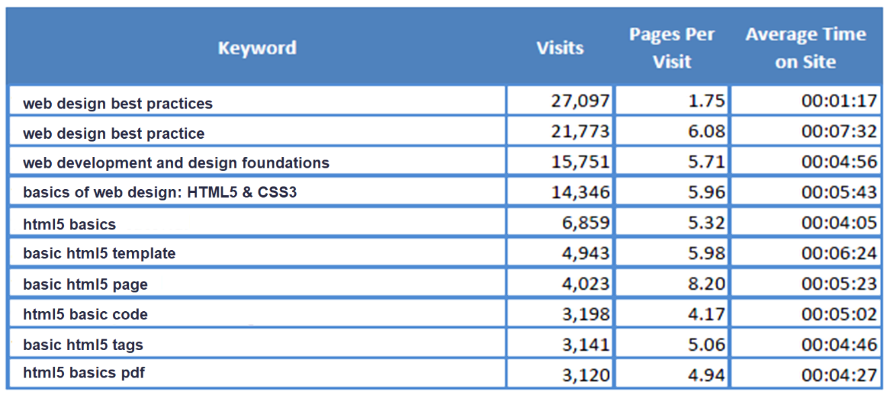
Monitor Search Engine Listings (2 of 2)
Analyze web site logs
Figure 13.2 Partial log file analysis report

Slide 27
Link Popularity
Rating determined by a search engine based on the number of sites that link to a particular website and the quality
Checking Link Popularity
Analyze your log file
Visit search engines and check for yourself:
At Google type the following into the search box:
link:yourdomainname.com

Slide 28
Social Media Optimization
Creating content of value that is easily sharable
Benefits:
Increased brand awareness
Increased inbound links
Make sharing easy
Social Bookmarking.
http://addthis.com
Twitter, Facebook, Pinterest, Digg, Reddit, LinkedIn, YouTube, ….

Slide 29
Other Site Promotion Activities (1 of 2)
QR (Quick Response) Codes
Affiliate Programs
Banner Ads
Banner Exchange
Reciprocal Link Agreements
Newsletters
“Sticky” Site Features
Personal Recommendations

Slide 30
Other Site Promotion Activities (2 of 2)
Newsgroup and Listserv Postings
Traditional Media Ads
Leverage Existing Marketing Materials

Slide 31
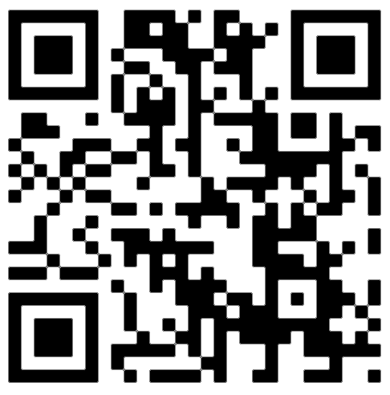
QR (Quick Response) Code
A two-dimensional barcode in a square pattern that is readable by a smartphone camera scan application or a QR barcode reader
Free online QR code generators:
http://qrcode.kaywa.com
http://www.qrstuff.com
http://www.labeljoy.com/en/generate-qr-code.html

Slide 32
Checkpoint (2 of 3)
Are the results returned by various search engines really different?
Choose a place, music group, or movie to search for.
Enter the same search terms, such as “Door County” into the following three search engines: Google, Yahoo!, Bing.
List the URLs of the top three sites returned by each.
Comment on your findings.

Slide 33
Checkpoint (3 of 3)
How can you determine if your web site has been indexed by a search engine?
How can you determine which search engines are being used to find your site?
List four web site promotion methods that do not use search engines.
Which would be your first choice? Why?

Slide 34
Inline Frame
Also called a floating frame
Embeds one web page within another in a scrolling area
Configure with the iframe element
<iframe src="trillium.html" title="Trillium Wild Flower" height="160" name="flower" width="350"> Description of the lovely Spring wild flower, the <a href="trillium.html" target="_blank">Trillium</a>
</iframe>

Slide 35
Use the iframe element to embed a YouTube Video (1 of 2)
<iframe src="http://www.youtube.com/embed/VIDEO_ID" width="640" height="385"> View the <a href="https://youtu.be/VIDEO_ID">YouTube Video</a> </iframe>

Slide 36
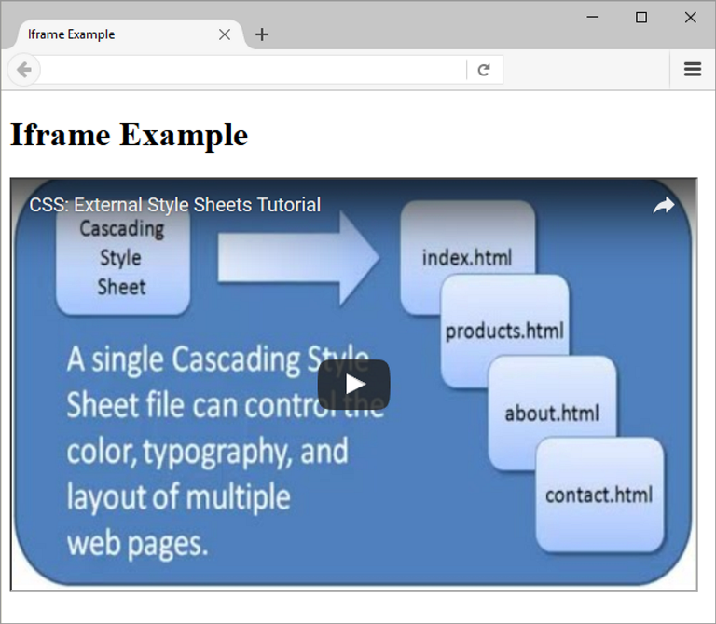
Use the iframe element to embed a YouTube Video (2 of 2)
See StudentFiles/Chapter13/13.1/iframe.html

Slide 37
Summary (1 of 2)
This chapter introduced concepts related to promoting your website.
Techniques for search engine optimization were discussed.
The activities involved in submitting websites to search engines and search directories were discussed along with techniques for making your website more useful to search engines.
The new trend of social media optimization was introduced.

Slide 38
Summary (2 of 2)
Other web site promotion activities such as banner ads and QR codes were also discussed.
You can help the marketing staff by creating websites that work with search engines and directories by following the suggestions in this chapter.

